Slide 2
Learn how job execution is carried out in classic MapReduce.

Slide 3
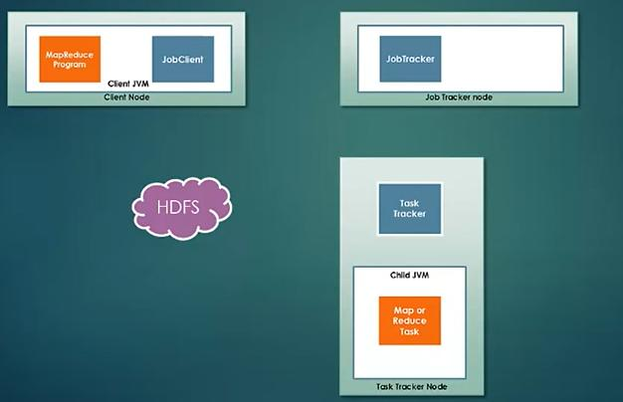

Slide 4
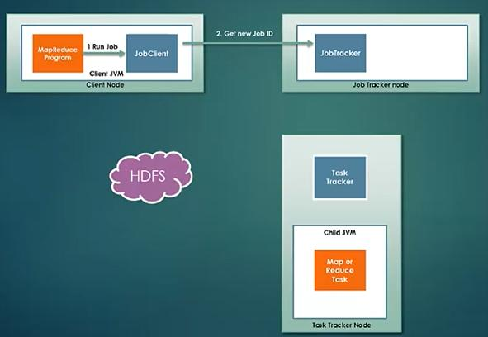
Job Submission
JobClient get new job ID.

Slide 5
Job Submission
JobClient get new job ID.
Output has been created or not

Slide 6
Job Submission
JobClient get new job ID.
Output has been created or not
Calculate the splits

Slide 7
Job Submission
JobClient get new job ID.
Output has been created or not
Calculate the splits
Copies the resources to HDFS

Slide 8
Job Submission
JobClient get new job ID.
Output has been created or not
Calculate the splits
Copies the resources to HDFS
Submits the job

Slide 9
Job Submission
JobClient get new job ID.
Output has been created or not
Calculate the splits
Copies the resources to HDFS
Submits the job
JobClient creates an instance of JobSubmitter

Slide 10
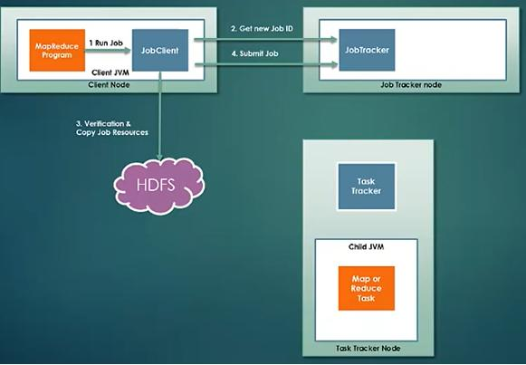
Job Initialization
Scheduler picks the job from the queue.

Slide 11
Job Initialization
Scheduler picks the job from the queue.
Creates an object which encapsulates its tasks and does book keeping

Slide 12
Job Initialization
Scheduler picks the job from the queue.
Creates an object which encapsulates its tasks and does book keeping
Creates 1 Map task per split.

Slide 13
Job Initialization
Scheduler picks the job from the queue.
Creates an object which encapsulates its tasks and does book keeping
Creates 1 Map task per split.
Number of reducers are decided by
“Mapred.reduce.tasks”
“job.setNumReduceTasks()”

Slide 14
Job Initialization
Scheduler picks the job from the queue.
Creates an object which encapsulates its tasks and does book keeping
Creates 1 Map task per split.
Number of reducers are decided by
“Mapred.reduce.tasks”
“job.setNumReduceTasks()”
Creates setup and cleanup jobs on task trackers.

Slide 15
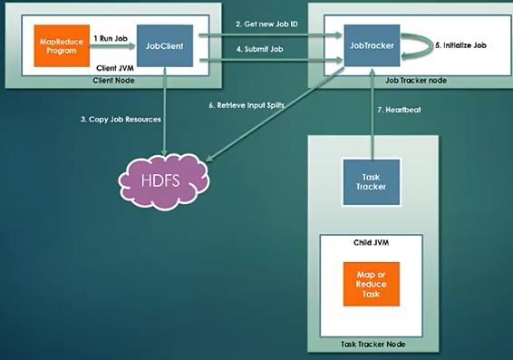
Task Assignment
TaskTracker runs a simple loop that periodically sends heartbeat.

Slide 16
Task Assignment
TaskTracker runs a simple loop that periodically sends heartbeat.
TaskTracker have fixed number of slots to run Map and Reduce Tasks

Slide 17
Task Assignment
TaskTracker runs a simple loop that periodically sends heartbeat.
TaskTracker have fixed number of slots to run Map and Reduce Tasks
The number of tasks that can run be modified considering memory an cores of the processing node.

Slide 18
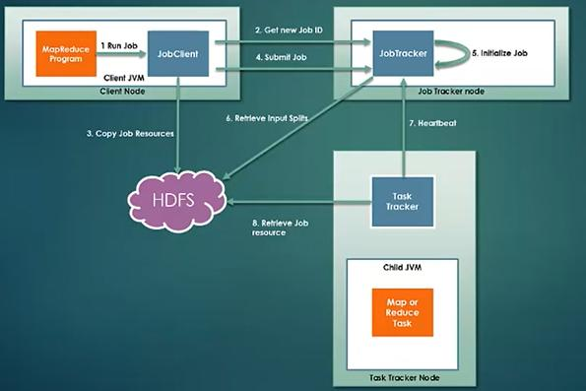
Task Execution
Retrieve the JAR file from the HDFS.

Slide 19
Task Execution
Retrieve the JAR file from the HDFS.
Launches JVM to run

Slide 20
Task Execution
Retrieve the JAR file from the HDFS.
Launches JVM to run
TaskTracker sends regular updates to JobTracker about the statuses.

Slide 21
Task Execution
Retrieve the JAR file from the HDFS.
Launches JVM to run
TaskTracker sends regular updates to JobTracker about the statuses.
Cleanup job run after completion of reduce tasks

Slide 22
Progress and Update Calculation
For Maptasks, the percentage is simple to calculate.
As input split size and the amount of data processed is known at any given time.
For reduce, it’s a little tricky.

Slide 23
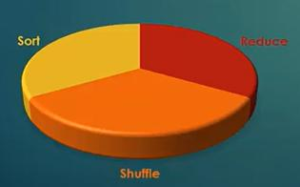
Progress and Update Calculation
If just started with reduce phase, completion would be:

Slide 24
Progress and Update Calculation
If just started with reduce phase, completion would be:
1/3 (Sort) + 1/3 (Shuffle) = 2/3 or 67%

Slide 25
Progress and Update Calculation
If just half of reduce phase is done, then completion would be:

Slide 26
Progress and Update Calculation
If just half of reduce phase is done, then completion would be:
1/3 (Sort) + 1/3 (Shuffle) +1/6 (Reduce) = 5/6 or 83%

Slide 27
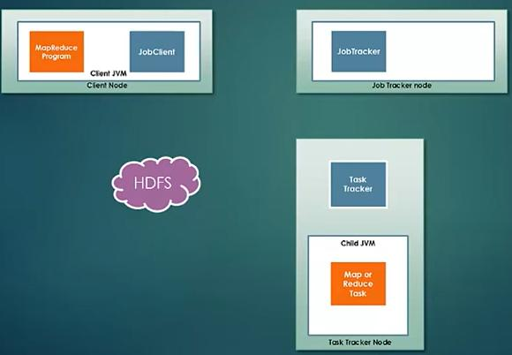

Slide 28
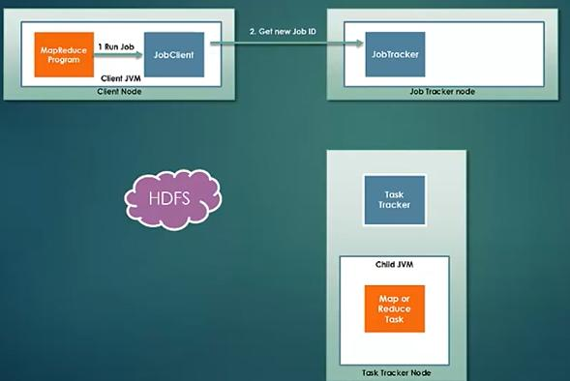
Job Submission

Slide 29
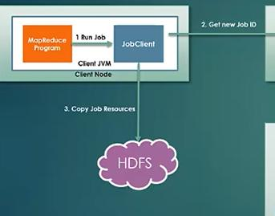

Slide 30
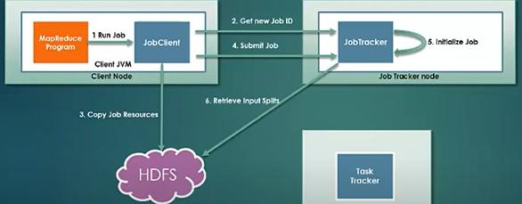
Task Intialization

Slide 31
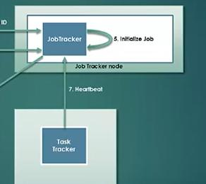
Task Assignment

Slide 32
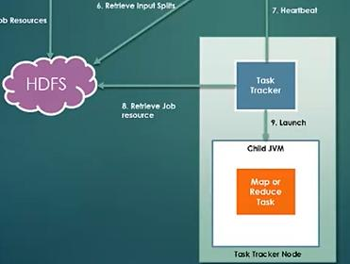
Task Execution

Slide 33
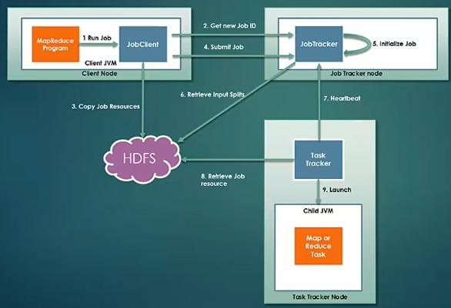
Job Completion

